Slide 1
B09S0061 Software Engineering
Lecture 2
Instructor: Liu, Guangchi Ph.D.
2025/02/28
Notes:
本模板基于“中国科学院大学-路人丁-PPT模板”魔改而成，著作权归该作者所有。
本模板中使用的东南大学校徽、校标文字组合、校训文字等素材来自于微信公众号“金木屋”。
本模板的视觉设计参考了“东南大学视觉识别系统”。
人物介绍页头像素材来自 小肥柴。
本模板力求简洁，布局合理，主次分明。以学术风为设计理念，适用于学术报告与论文答辩等相关应用场景。模板未使用任何动画效果。
您仅可以以个人非商业用途使用本PPT模板，不可将信息内容的全部或部分用以出售，或以出租、出借、转让、分销、发布等其他任何方式供其他人使用。
欢迎 持续关注东南大学止于至善学术风 PPT 模板 （https://zhuanlan.zhihu.com/p/335298500）后续的功能优化及多语言更新版本。
最后，祝汇报顺利，马到成功！
Version: (2021) v1.5-en.

Slide 2
01
PART ONE
Software Development Process

Slide 3
Sequence of Processes
Lecture 1 introduced several process steps: Requirements
User interface design
System design
Program development (design and coding)
Acceptance and release
Every software project will include these basic steps, in some shape or form, but: The steps may be formal or informal.
The steps may be carried out in various sequences.
A software development process or methodology is a systematic way of combining these steps to build a software system.

Slide 4
Software Development Processes
Waterfall model
Complete each process step before beginning the next.
Iterative refinement
Go quickly through all the steps to create a rough system, then repeat them to improve the system
Spiral
A variant of iterative refinement in which new and updated components are added to the developing system as they are completed.
Agile development
Small increments of software are developed in a sequence of sprints, eachof which creates deployable code.

Slide 5
Heavyweight and Lightweight Software Development
In a heavyweight process, the aim is to fully complete each step and have minimal changes and revisions later. Each step is fully documented before beginning the next.
Example: Modified Waterfall Model
In a lightweight process, the development team has minimal intermediate documentation. There is an expectation that changes will be made based on experience, and only the final system will be documented.
Example: Agile Software Development

Slide 6
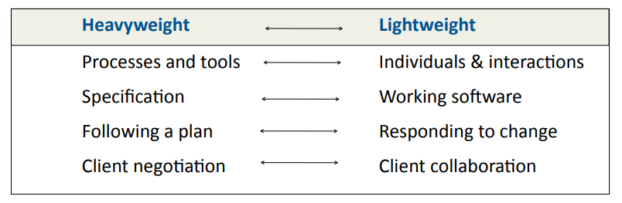
Heavyweight and Lightweight Methodologies
过程和工具 v.s. 个体和交互
面面俱到的文档 v.s. 可以工作的软件
遵循计划 v.s. 响应变化
合同谈判 v.s.客户合作
Based on the Manifesto for Agile Software Development:
http://agilemanifesto.org

Slide 7
History
Software engineering, as a discipline, dates from the early 1970s.
At that time:
Most computer systems were conversions of systems that had previously been done manually, e.g., payroll, billing, airline reservations. The requirements were well understood.
Many systems followed the same architecture, Master File Update. The system design was well understood.
Coding was tedious with none of the modern languages and tools. Therefore, it was important to have a good program design before beginning to code.
These factors led to the Waterfall Model of software development.

Slide 8
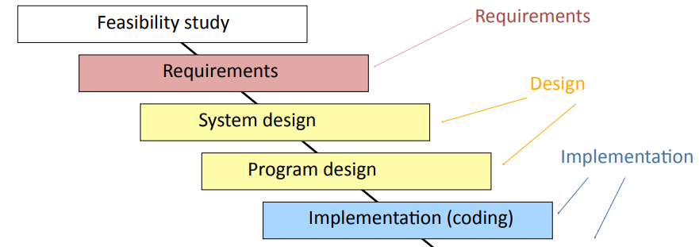
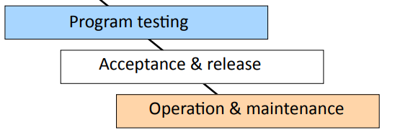
The Waterfall Model
There are problems with this basic model and it is rarely used in practice.

Slide 9
The Waterfall Model
The waterfall model is a heavyweight process with full documentation of each process step.
Advantages:
Separation of tasks
Process visibility
Quality control at each step
Cost monitoring at each step
Disadvantages:
In practice, each stage in the process reveals new understanding of the previous stages, which often requires the earlier stages to be revised.
The Waterfall Model is not flexible enough.

Slide 10
The Waterfall Model
A pure sequential model is not possible.
The plan must allow for some form of iteration.
Examples:
A feasibility study cannot create a proposed budget and schedule without a preliminary study of the requirements and a tentative design.
Detailed design and implementation reveal gaps in the requirements specification.
Requirements and/or technology may change during the development.
计划赶不上变化！

Slide 11
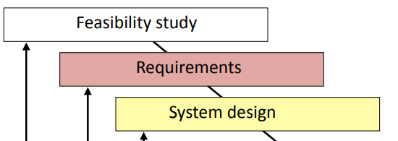
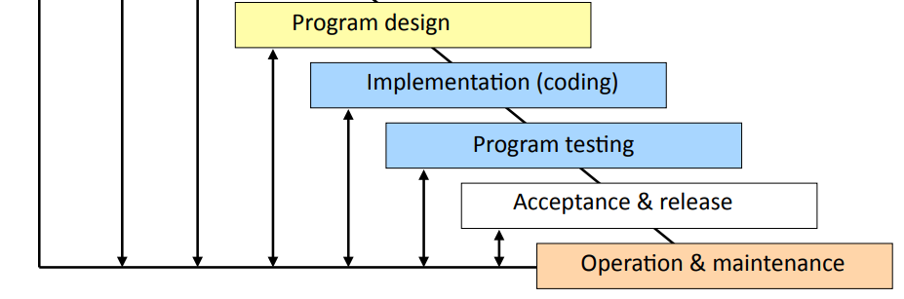
Modified Waterfall Model
Waterfall model with feedback
This is better

Slide 12
When to Use the Modified Waterfall Model
The Modified Waterfall Model works best when the requirements are well understood and the design is straightforward, e.g.
Converting a manual data processing systems where the requirements were well understood (e.g., electricity billing).
New version of a system where the functionality is closely derived from an earlier product (e.g. automatic braking system for a car).
Portions of a large system where some components have clearly defined requirements and are clearly separated from the rest of the system.

Slide 13
Iterative Refinement
Concept
Requirements are hard to understand until there is an operational system, particularly with user interfaces.
System and program design may benefit from prototypes.
Process
Create a prototype system early in the development process.
Review the prototype with clients and test it with users, to improve the understanding of the requirements and clarify the design.
Refine the prototype in a series of iterations.

Slide 14
Iterative Refinement: an Example
Problem: Add graphics package to a programming environment
Requirements
The client was unsure of several important requirements, e.g, syntax for how to manage coordinates across different objects.
Process
Build a prototype version with a preprocessor and preliminary run-time package.
Have several iterations. For each iteration:
test the system with users
make modifications
repeat until users are pleased with function
As a final iteration, replace the preprocessor and eliminate patches and short cuts in the run-time package.
This is an example of iterative refinement.

Slide 15
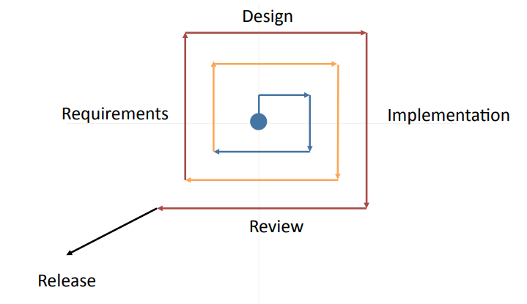
Iterative Refinement

Slide 16
Discussion of Iterative Refinement
This is a medium weight process with documentation created during the process.
Iterative refinement uses various techniques that enable the client to review the planned system early during development:
User interface mock-ups
Throw-away software components
Dummy modules
Rapid prototyping
Successive refinement
Get something working as quickly as possible, for client and user evaluation, but do not release it.
Fake it until you make it

Slide 17
Spiral Development
Example
Developing a new version of an operating system (Microsoft).
Spiral development
With spiral development there is always a fully tested system, but the functionality is incomplete.
Create a base system that has the overall structure of the final product with dummy stubs for missing components.
For every completed component, create a comprehensive set of test cases.
Development teams build new or improved components, each with a set of test cases. Add these components to the source code library.
On a daily cycle, testers build the entire system from the source code library and run the complete set of test cases.

Slide 18
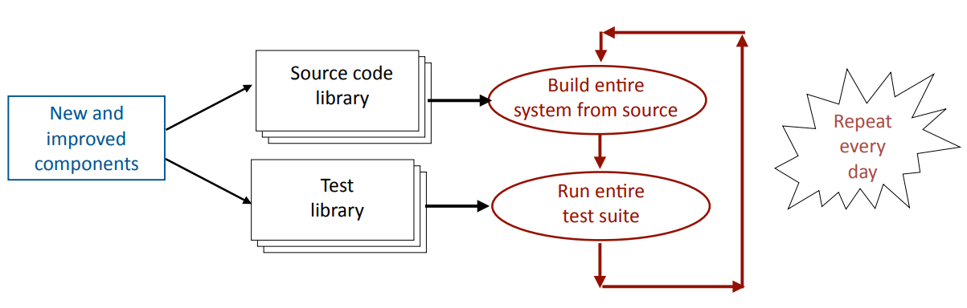
Spiral Development

Slide 19
Discussion of Spiral Development
Spiral development is widely used to develop new versions of large systems:
The overall system architecture is well understood.
Large components can be developed and tested separately.
The importance of the system justifies the overhead of setting up a comprehensive set of automated tests.
Challenges
Difficult to make major changes to the architecture.
Difficult to make changes that effect many components.

Slide 20
Incremental Release of Online Systems
It is easier for a small team to develop a small system correctly than to coordinate large projects with many ramifications.
With web sites and other online software it is often possible to release a very basic system and add extra functionality in a sequence of short sprints.
Example:
Start-up company delivering from shops to homes.
Advantages
Pay-back on investment begins soon.
Requirement are more clearly understood in developing subsequent sprints – minimize wasted effort.
Feedback from customers and clients can be incorporated in later phases.

Slide 21
Agile Methods
The term Agile is used for a variety of methods.
General principles:
A large project is divided into small increments called sprints.
The development is carried out by small teams of 4 to 9 people.
The schedule is divided into fixed time boxes, perhaps 2 to 4 weeks.
Each sprint is a time box during which the team completes part of a software project. A single sprint will go through several process steps, such as requirements, design, coding, and testing. Each sprint ends with fully tested code, ready to be put into production.
This is a lightweight process with minimal documentation created during the process, but the final version needs full documentation for future maintenance.

Slide 22
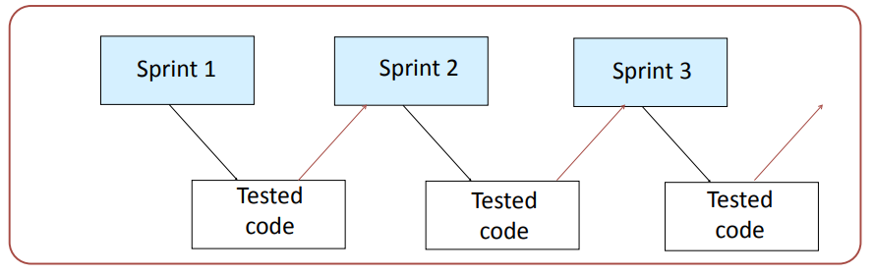
Agile Development
After each sprint the code may be:
released (original agile method)
combined with code from other sprints for subsequent release
incorporated into a larger code base (spiral development)

Slide 23
Agile: Releasing Code
Versions of agile
The original version of agile required each sprint to end with released code. This is rarely possible in practice.
In this course, we define a sprint to create production quality code.
Some people use the term “sprint” to cover any short activity, but this is beyond the agile spirit.

Slide 24
Agile Development: Rework
The challenge of agile development
The agile approach is excellent for the development or continual enhancement of a system within an established architecture.
A high-level team must establish the overall architecture and coordinate the sprints.
Rework
With agile development the requirements and design of the overall system emerge incrementally.
Inevitably parts of some early sprints will need to be reworked.
This requires changes to code that has already been fully tested and may have been released. This is always awkward.
If the volume of rework is large, it is more efficient not to fully polish each component, but to use iterative refinement to minimize the amount of rework.

Slide 25
Mixed Processes
In practice, many large projects use processes that mix aspects of the four types of software process.
Examples
A project with well-understood requirements might use a modified waterfall approach to specify the requirements and system design, followed by a series of agile sprints.
A project with vague requirements might use iterative refinement to clarify the requirements, followed by a modified waterfall model to build the final version.
With spiral development, new components may be developed as a series of sprints.
User interfaces have to be tested with users. This forces iterative development, whatever process is used for the rest of the system.

Slide 26
Mixed Processes: Phased Development
Divide a large project into two or more phases.
A first version of the system with basic functionality is brought quickly into production (Phase 1).
Subsequent phases are based on experience gained from users of the previous phase.
Advantages
Pay-back on investment begins soon.
Requirement are more clearly understood when developing subsequent phases.
Costs can be spread out over longer time periods.

Slide 27
Observations about Software Processes
Completed projects should have included all the basic process steps but ... the development process is always partly evolutionary.
Risk is lowered by:
Prototyping key components
Frequent releases, or dividing large projects into phases
Early and repeated testing with users and customers
Following a visible software process
It is never possible to complete each step without provision for revision

Slide 28
Choosing a Software Process
Changes during the software development process are expensive.
If the requirements are poorly understood or expected to change, select a process that keeps flexibility. Iterative refinement, agile sprints, phased implementation.
If a big software system has many inter-related components, avoid major changes to the design of a system during development. Modified waterfall model.
If the market for the software is poorly understood, use a process that gets operational software in front of customers as quickly as possible. Agile sprints.

Slide 29
Corporate Processes
Large software development organizations have their own internal processes that are designed for their needs. For example:
Amazon (Internet commerce) was a pioneer in using agile methods. Most software development is divided into sprints of about four weeks elapsed time.
Move fast and break things
Lockheed Martin (government contractor) follows a modified waterfall model that fits with the way that the US government manages software contracts.
Microsoft (PC software) places great emphasis on testing with a very wide variety of equipment and backwards compatibility. Much of the development uses a spiral process.

Slide 30
Fashion and Buzz Words
Every few years a new software methodology gets great publicity.
Recent examples include heroic programming, agile, scrum, devOps, Jenkins pipeline, etc.
All claim to be a vast improvement over previous ways of developing software.
Most include some good ideas, but others are simple reformulations of old concepts.
Each new methodology invents new buzz words.
Don’t be fooled by marketing.
There is no development process that works for all types of software.
Even the best processes need skilled developers to create good, secure, reliable, systems

Slide 31
Requirements on Final Project
1. Describe the process used in your project and explain why

Slide 32
02
PART TWO
Feasibility Studies

Slide 33
Feasibility Study
夫未战而庙算胜者，得算多也，未战而庙算不胜者，得算少也。多算胜，少算不胜，而况于无算乎！
——《孙子兵法·计篇》

Slide 34
Feasibility Study
A feasibility study is a study made before committing to a project.
A feasibility study leads to a decision:
• go ahead
• do not go ahead
In production projects, the feasibility study often leads to a budget request.
A feasibility study may be in the form of a proposal.

Slide 35
Why are Feasibility Studies Difficult?
Uncertainty
Clients may be unsure of the scope of the project.
Benefits are usually very hard to quantify.
Approach is usually ill-defined. Estimates of resources and timetable are very rough.
Organizational changes may be needed.
Therefore, feasibility studies rely heavily on the judgment of experienced people.
Mistakes made at the beginning of a project are the most difficult to correct.

Slide 36

Why are Feasibility Studies Difficult?
Advocacy
Advocacy is needed to build enthusiasm for a project: to convince an organization to undertake an expensive, complex project with many risks.
Enthusiasm is good, but enthusiasts usually emphasize potential benefits and downplay risks.
People carrying out the feasibility study and making the decision often have a vested interest in the project going ahead, e.g., financial gain, career development.

Slide 37
The Decision Maker's Viewpoint
The feasibility study makes recommendations.
Senior member(s) of the client’s organization decide whether to begin a major software project. What information do they needed?
Client: Who is this project for?
Scope: What are the boundaries of the project?
Benefits: What are the benefits? Can they be quantified? If the software is a product, what are the forecasts of likely sales?
Technical: Is the project possible? Is there at least one technical way to carry out the project?
Resources: What are the estimates of staff, time, equipment, etc.?
Alternatives: What are the options if the project is not done?

Slide 38
Where are the Risks? Can they be Minimized?
Technical risks
There must be an outline plan with a rough timetable and staff allocation.
The plan must have a very large margin for contingencies. (Projects typically require twice the staff and/or time envisaged in the feasibility plan.)
External
Every system interacts with others Are the others committed to the necessary efforts(e.g.,potential users and customers)?
Where are the external pressures and obstacles?

Slide 39
Organizational Feasibility
A major computer system makes demands on an organization:
Does the organization have the management expertise?
Does the organization have the technical expertise? Even if the work is carried out by a contractor, the organization needs expertise to oversee the work.
Is the organization committed to the changes in personnel, workflow, etc.?
Example
Copyright deposit system: clerical workflow.

Slide 40
Feasibility Study: Scope
Scope expresses the boundaries of the system:
• It will have a list of included functions
• It will have a list of excluded functions
• It will have a list of dependencies
• It will have a list of current systems to be replaced
Confusion over scope is a common reason for clients to be dissatisfied with a system.
"Is that all you planned to do?" "But I assumed that you were going to do xyz." "I can't use the system without abc."

Slide 41
Feasibility Study: Benefits
Why is this project proposed? Can you quantify the benefits?
Organization benefits
• Create a marketable product
• Improve the efficiency of an organization (e.g., save staff)
• Control a system that is too complex to control manually
• New or improved service(e.g., faster response to customers)
• Safety or security
Professional benefits are not the reason for doing a project

Slide 42
Feasibility Study: Technical
A feasibility study needs to demonstrate that the proposed system is technically feasible.
This requires:
• an outline of the requirements
• a possible system design (e.g., database, distributed, etc.)
• possible choices of software to be acquired or developed
• estimates of numbers of users, data, transactions, etc.
These rough numbers are part of the provisional plan that is used to estimate the staffing, timetable, equipment needs, etc.
The technical approach actually followed may be very different.

Slide 43
Feasibility Study: Planning and Resources
The feasibility study must include an outline plan:
Estimate the staffing and equipment needs, and the preliminary timetable
Identify major milestones and decision points
Identify interactions with and dependences on external systems
Provide a preliminary list of deliverables and delivery dates
There is a separate lecture about Project Management.

Slide 44
Feasibility Study: Alternatives and Risks
A feasibility study should identify risks and alternatives.
Risks
• What can go wrong?
• How will progress be monitored and problems identified (visibility)?
• What are the fall back options?
Alternatives
• Continue with current system, enhance it, or create new one?
• Develop in-house, or contract out? (How will a contract be managed?)
• Phases of delivery and possible points for revising plan.

Slide 45
Techniques for Feasibility Studies
The highest priority is to ensure that the client and development team have the same understanding of the goals of the system.
For the development team to understand the goals:
• Interviews with client and the staff of the client’s organization
• Review of existing systems (including competitors’) For the client to appreciate the proposed system:
• Demonstration of key features or similar systems
• Mock-up of user interfaces
• Walk through typical transactions or interactions

Slide 46
Techniques for Feasibility Studies
Outline budget:
• n people for m months at $x per month
• equipment, buildings, etc.
• contingency (at least 50% is needed)
Phases/milestones:
• specify deliverables and approximate dates
• planned releases

Slide 47
Feasibility Study: Decision
Different organizations and senior managers have different styles for feasibility studies, e.g., some decision makers:
• Monitor the team and the process
• Rely on detailed reading of a written report
• Rely on face-to-face questioning of knowledgeable people
But they must understand the decision.

Slide 48
Feasibility Report
A feasibility study should have a written report.
It should be a well written, well presented document.
• For a general audience: client, financial management, technical management,etc.
• Short enough that everybody reads it.
• Long enough that no important topics are skipped.
• Details can be included in supporting documents.
A report that is not read and understood is useless.

Slide 49
Requirements on Final Project
2. Include the feasibility report in your final report (Assuming the grader is the decision maker)

Slide 50
03
PART THREE
Project Management

Slide 51
The Aim of Project Management
To complete a project:
• On time
• On budget
• With required functionality
• To the satisfaction of the client
• Without exhausting the team
To provide visibility about the progress of a project
To give early warning of problems so that corrections can be made

Slide 52
The Challenge of Project Management
Clients wish to know:
Will the system do what was promised?
When will it be delivered? If late, how late?
How does the cost compare with the budget?
Often the software is part of a larger activity
• If the system is a product, marketing and development must be combined(e.g., Microsoft Office)
• If the system has to work with other systems, developments must be coordinated(e.g.,embedded systems in an automobile)
(continued on next slide)

Slide 53
The Challenge of Project Management (continued)
BUT:
Every software system is different.
Most systems are not well specified, or the requirements change during development.
Estimating time and effort is full of errors, even when the system is well understood.

Slide 54
Aspects of Project Management
Planning
• Outline schedule during feasibility study
• Fuller schedule for each part of a project (e.g., each process step,iteration, or sprint)
Contingency planning
• Anticipation of possible problems (risk management)
Progress tracking
• Regular comparison of progress against plan
• Regular modification of the plan
• Changes of scope, etc. made jointly by client and developers
Final analysis
• Analysis of project for improvements during next project

Slide 55
Terminology
Deliverable
• Work product that is provided to the client (mock-up, demonstration, prototype, report, presentation, documentation, code, etc.)
• Release of a system or subsystem to customers and users
Milestone
Completion of a specified set of activities (e.g., delivery of a deliverable, completion of a process step, end of a sprint)

Slide 56
Terminology
Activity
Part of a project that takes place over time (also known as a task)
Event
The end of a group of activities, e.g., agreement by all parties on the budget and plan
Dependency
An activity that cannot begin until some event is reached
Resource
Staff time, equipment, or other limited resource required by an activity

Slide 57
Standard Approach to Project Management
• The scope of the project is defined early in the process.
• The development is divided into tasks and milestones.
• Estimates are made of the time and resources needed for each task.
• The estimates are combined to create a schedule and a plan.
• Progress is continually reviewed against the plan, perhaps weekly.
• The plan is modified by changes to scope, time, resources, etc.
Typically the plan is managed by a separate project management team, not by the software developers.
Used with the Modified Waterfall Model and Iterative Refinement.

Slide 58
Agile Approach to Project Management
• Planning is divided into high level release forecasting and low level detailed planning.
• Release planning is a best guess, high level view of what can be achieved in a sequence of time-boxes.
• Release plans are continually modified, perhaps daily.
• Clients and developers take joint control of the release plans and choice of sprints.
• For each time-box, the team plans what it can achieve. The team may use Gantt charts or other conventional planning tools.

Slide 59
Estimating the Time for an Activity
With experienced staff, estimating the actual time to carry out a single task is usually fairly accurate, but ...
The little bits and pieces are underestimated.
• The time from almost "done" to completely "done" is much longer than anticipated. (There's just one thing to tidy up. I need to put the comments into better shape. I really should get rid of that patch.)
• The distractions are not planned for. (My system crashed and I decided to upgrade the software. My child's school was closed because of snow. I spent the day interviewing job candidates.)
• Some things have to be done twice.

Slide 60
Team Estimating
Agile approach to project management
• Different teams work at different speeds.
• The team has the best understanding of what it can achieve in a single time-box or sprint.
• The team commits to the outcome of a sprint.
Within the time box, the team must have an internal schedule.
With your project, you will need to commit to the outcome and have a schedule to manage your progress.

Slide 61
Start-up Time
On a big project, the start-up time is typically three to six months:
• Personnel have to complete previous projects (fatigue) or be recruited.
• Hardware and software has to be acquired and installed.
• Staff have to learn new domain areas and software (slow while learning).
• Clients may not be ready.
New companies have particular difficulties since they may have to hire staff, find office space,etc.

Slide 62
Project Planning Tools
Critical Path Method, Gantt charts, etc.
• Build a work-plan from activity data.
• Display work-plan in graphical or tabular form.
Project planning software (e.g., PingCode, Feishu, Jira)
• Maintain a database of activities and related data
• Calculate and display schedules
• Manage progress reports

Slide 63
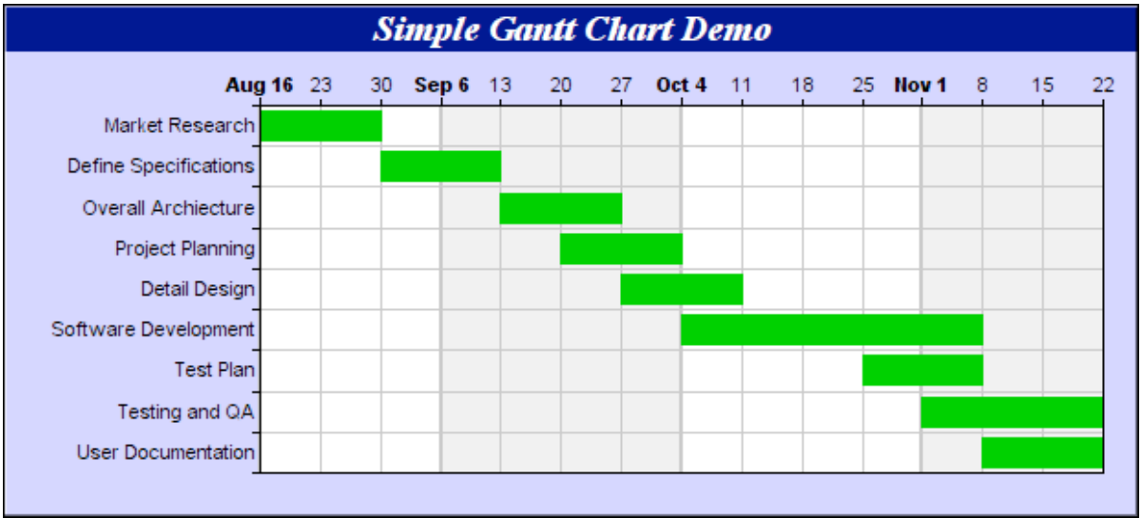
A Simple Gantt Chart
Source: Advanced SoIware Engineering Limited

Slide 64
Gantt Charts
Used for small projects, single time-boxes, and sprints
• Dates run along the top (days, weeks, or months).
• Each row represents an activity. Activities may be sequential, in parallel or overlapping.
• The schedule for an activity is a horizontal bar. The left end marks the planned beginning of the task. The right end marks the expected end date.
• The chart is updated by filling in each activity to a length proportional to the work accomplished. This is often difficult.
• Progress to date can be compared with the plan by drawing a vertical line through the chart at the current date.

Slide 65
Activity Graph
A group of scheduling techniques that emphasizes dependencies
An activity(task)
A dummy activity(dependency)
An event
A milestone

Slide 66
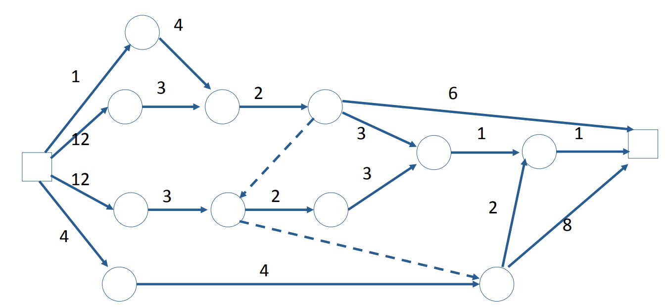
Example:Activity Graph w/ Time Estimate

Slide 67
Earliest Event Dates and Earliest Start Dates
Earliest start date: the earliest date that it is possible to start an activity.
Earliest event date: the date that all the activities ending at that node will be completed, assuming that every activity begins at its earliest start date.
Earliest project completion date: the date on which the project is completed assuming that every activity begins on its earliest start date.
These calculations all depend on the dependencies represented by the activity graph and the accuracy of the estimates of the time to carry out the individual tasks.

Slide 68
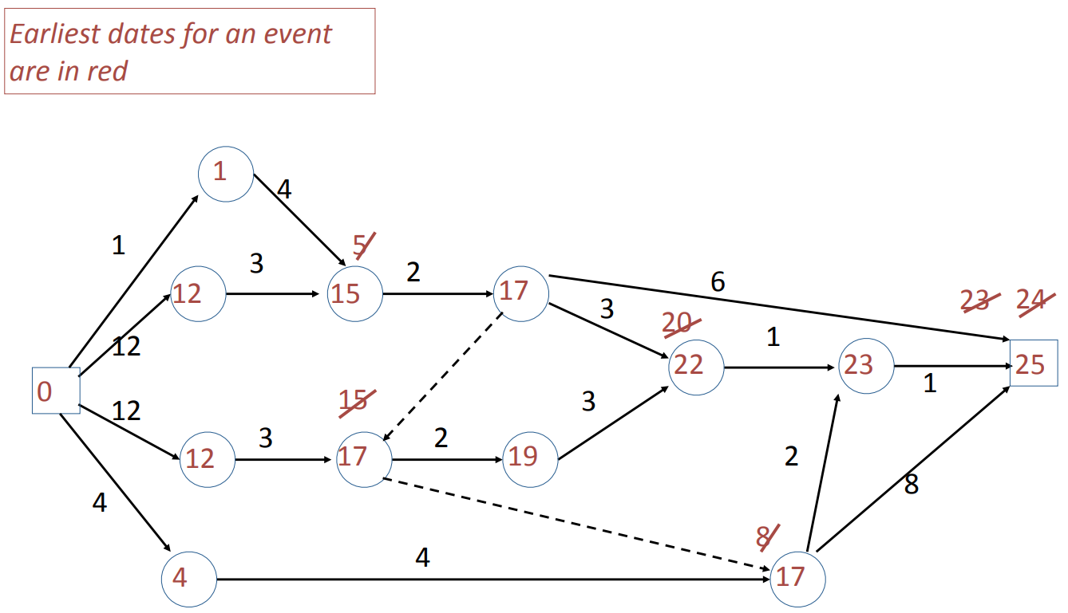
Earliest Event Dates and Earliest Start Dates

Slide 69
Latest Event Dates and Latest Start Dates
Latest start date: the latest date that it is possible to start an activity and still complete the project by the earliest project completion date.
Latest event date: the latest date that all the activities ending at that node must be completed, in order to complete the project by the earliest project completion date.

Slide 70
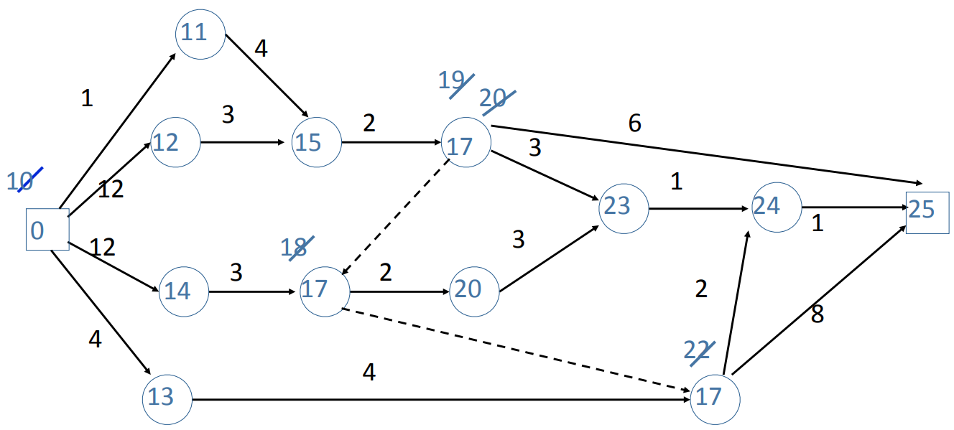
Latest Event Dates and Latest Start Dates
Latest event
dates in blue
Each event must be achieved by the date shown or the final date will not be met.

Slide 71
Critical Path
Events on the critical path have the earliest event date equal to the latest event date.
Every activity on the critical path must begin on the earliest start date.
Critical path in orange

Slide 72
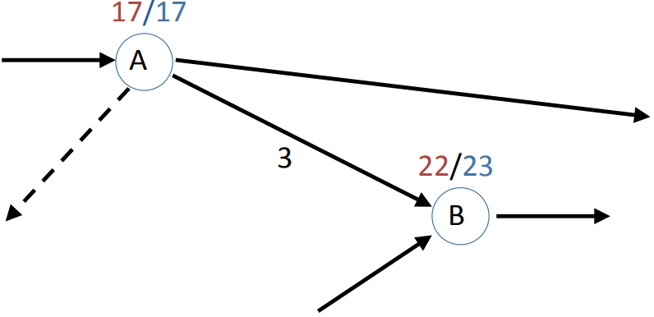
Slack
Activities not on the critical path have slack.
The earliest start date for this activity is 17. It must be completed by week 23. Since its duration is 3 weeks, it can be started any time between week 17 and 20. This give a slack of 3 weeks.

Slide 73
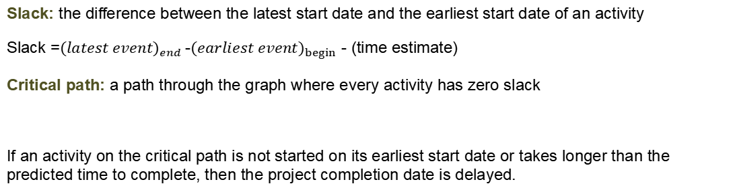
Slack and Critical Path
Slack: the difference between the latest start date and the earliest start date of an activity
Slack =${(latest event)}_{end}$-${(earliest event)}_{begin}$ - (time estimate)
Critical path: a path through the graph where every activity has zero slack
If an activity on the critical path is not started on its earliest start date or takes longer than the predicted time to complete, then the project completion date is delayed.

Slide 74
Using the Critical Path Method to Identify Problems
The earlier that a problem is known, the easier it is to fix.
Example
Purchase key item of equipment earlier than anticipated.

Slide 75
Adding Resources to Activity Graph or Gantt Chart
Each activity is labeled with resources, e.g.,
Number of people(e.g., 2 Java programmers)
Key personnel (e.g., chief system architect)
Equipment (e.g., 3 servers with specified software)
Facilities (e.g., video conference center)
Each resource is labeled with availability, e.g.,
Hiring and training
Vacations
Equipment availability

Slide 76
Using Activity Graphs for Resources
Assume every activity begins at earliest start date:
In each time period, calculate:
resources required
resources available
Identify shortage/surplus resources
Adjust schedule
acquire extra staff (e.g., consultants)
rearrange schedule (e.g., change vacations)
change order of carrying out activities

Slide 77
Key Personnel: The Mythical Man Month
In computing, not all people are equal
• Some people are much more productive (e.g., more experienced).
• Some tasks are too difficult for everybody.
Adding more people adds communications complexity
• Some activities need a single mind.
• Sometimes, the elapsed time for an activity can not be shortened.
• Adding more people may increase the time to complete a project.
What happens to the project if a key person is sick or quits?

Slide 78
Managing the Schedule
The schedule may be managed by a member of the team or by an external project manager.
• Create and maintain the schedule.
• Track progress against schedule.
• Check for slack in the schedule (minimize risk).
• Continually make adjustments:
Start activities before previous activities complete
Sub-contract activities
Renegotiate deliverables
• Keep senior management informed (visibility).
Needs the confidence of the team members.

Slide 79
Requirements on Final Project
3. Describe your project plan/schedule in your final report, with the techniques & components introduced in this part

Slide 80
Thanks for your listening!
Instructor: Liu, Guangchi Ph.D.
2025/02/28

